Slide 1
Network Security
Unit 6

Slide 2
Network Security
Network security is the security provided to a network from unauthorized access and risks. It is the duty of network administrators to adopt preventive measures to protect their networks from potential security threats.
The most common and simple way of protecting a network resource is by assigning it a unique name and a corresponding password.
Network Security refers to the measures taken by any enterprise or organization to secure its computer network and data using both hardware and software systems.
This aims at securing the confidentiality and accessibility of the data and network. Every company or organization that handles a large amount of data, has a degree of solutions against many cyber threats.
The network security solutions protect various vulnerabilities of the computer systems such as: 1. Users 2. Locations 3. Data 4. Devices 5. Applications

Slide 3
Network Security
Network Security: Working The basic principle of network security is protecting huge stored data and networks in layers that ensure the bedding of rules and regulations that have to be acknowledged before performing any activity on the data.
These levels are:
1. Physical
2. Technical
3. Administrative

Slide 4
Network Security
Physical Network Security: This is the most basic level that includes protecting the data and network through unauthorized personnel from acquiring control over the confidentiality of the network. These include external peripherals and routers that might be used for cable connections. The same can be achieved by using devices like biometric systems.
Technical Network Security: It primarily focuses on protecting the data stored in the network or data involved in transitions through the network. This type serves two purposes. One is protected from unauthorized users, and the other is protection from malicious activities.
Administrative Network Security: This level of network security protects user behavior like how the permission has been granted and how the authorization process takes place. This also ensures the level of sophistication the network might need for protecting it through all the attacks. This level also suggests necessary amendments that have to be done to the infrastructure.

Slide 5
Network Security
Types of Network Security:
Access Control: Not every person should have a complete allowance for the accessibility to the network or its data. One way to examine this is by going through each personnel’s details. This is done through Network Access Control which ensures that only a handful of authorized personnel must be able to work with the allowed amount of resources.
Antivirus and Anti-malware Software: This type of network security ensures that any malicious software does not enter the network and jeopardize the security of the data. The malicious software like Viruses, Trojans, and Worms is handled by the same. This ensures that not only the entry of the malware is protected but also that the system is well equipped to fight once it has entered.
Cloud Security: Now a day, a lot many organizations are joining hands with cloud technology where a large amount of important data is stored over the internet. This is very vulnerable to the malpractices that few unauthorized dealers might pertain. This data must be protected and it should be ensured that this protection is not jeopardized by anything. Many businesses embrace SaaS applications for providing some of their employees the allowance of accessing the data stored over the cloud.

Slide 6
Active attacks
An Active attack attempts to alter system resources or affect their operations.
Active attacks involve some modification of the data stream or the creation of false statements.
Active attacks involve an attacker intentionally altering or destroying data, or disrupting the normal operation of a system.
Ex: active attacks include denial of service (DoS), where an attacker floods a system with traffic in an attempt to make it unavailable to legitimate users, and malware, where an attacker installs malicious software on a system to steal or destroy data.
Types of active attacks are as follows:
Masquerade
Modification of messages
Repudiation
Replay
Denial of Service

Slide 7
Passive attacks
A Passive attack attempts to learn or make use of information from the system but does not affect system resources.
Passive Attacks are in the nature of eavesdropping on or monitoring transmission.
The goal of the opponent is to obtain information that is being transmitted.
Passive attacks involve an attacker passively monitoring or collecting data without altering or destroying it.
Ex: Passive attacks include eavesdropping, where an attacker listens in on network traffic to collect sensitive information, and sniffing, where an attacker captures and analyzes data packets to steal sensitive information.
Types of Passive attacks are as follows:
The release of message content
Traffic analysis

Slide 8
Cryptography
Cryptography is technique of securing information and communications through use of codes so that only those person for whom the information is intended can understand it and process it. Use to prevent unauthorized access to information.
The prefix “crypt” means “hidden” and suffix graphy means “writing”.
In Cryptography the techniques which are use to protect information are obtained from mathematical concepts and a set of rule based calculations known as algorithms to convert messages in ways that make it hard to decode it.
These algorithms are used for cryptographic key generation, digital signing, verification to protect data privacy, web browsing on internet and to protect confidential transactions such as credit card and debit card transactions.
Techniques used For Cryptography: Cryptography is often associated with the process where an ordinary plain text is converted to cipher text which is the text made such that intended receiver of the text can only decode it and hence this process is known as encryption.
The process of conversion of cipher text to plain text this is known as decryption.

Slide 9
Symmetric Cryptography
Symmetric encryption is a form of encryption whereby the same key is used to encrypt and decrypt the message.
This is different from asymmetric or public-key encryption, which uses one key to encrypt a message and another key to decrypt the message.
Symmetric encryption is a kind of computerized cryptography, which uses a particular encryption key to conceal the contents of an electronic message.
Its data conversion utilizes a mathematical procedure along with a private key, which results in the potential failure to make sense of a message for somebody who doesn’t have the right tools to decrypt it.
Symmetric encryption is a two-way algorithm because the mathematical procedure is turned back when decrypting the message, along with using the same private key.
Symmetric encryption is also referred to as private-key encryption and secure-key encryption.

Slide 10
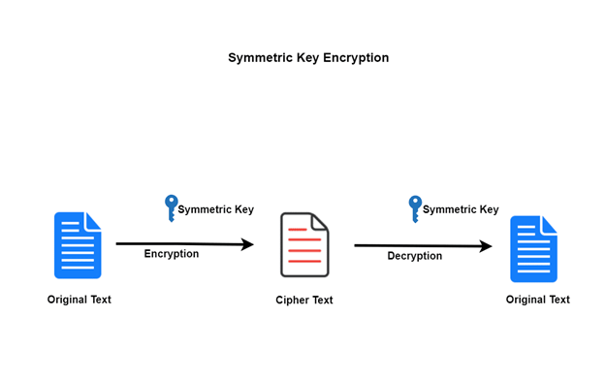
Symmetric Cryptography

Slide 11
Asymmetric Cryptography
Public-key encryption, a mix of a private key and a public key, utilizes two separate keys.
The private key must stay exclusive to its individual holders, while the public key must be made open to anybody by a library or vault that is unreservedly available.
A machine may utilize the public key, given by the starting gadget, and its own private key to decode an encoded message.
While a message sent starting with one gadget then onto the next would not be secure since the public key utilized for encryption is accessible and open to everybody, without the private key, somebody who gets it won’t read it.

Slide 12
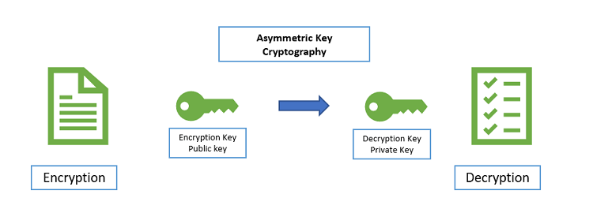
Asymmetric Cryptography

Slide 13
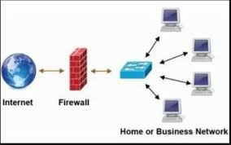
Firewall
Firewall is a tool that prevents unauthorized access
and keeps our computers and data safe and secure.
Special type of network security device or a software program that monitors and filters incoming and outgoing network traffic based on a defined set of security rules.
It acts as a barrier between internal private networks and external sources (such as the public Internet).
The primary purpose of a firewall is to allow non-threatening traffic and prevent malicious or unwanted data traffic for protecting the computer from viruses and attacks.
A firewall is a cybersecurity tool that filters network traffic and helps users block malicious software from accessing the Internet in infected computers.

Slide 14
Firewall
Types of Firewall
Firewalls are generally of two types: Host-based and Network-based.
Host- based Firewalls : Host-based firewall is installed on each network node which controls each incoming and outgoing packet. It is a software application or suite of applications, comes as a part of the operating system. Host-based firewalls are needed because network firewalls cannot provide protection inside a trusted network. Host firewall protects each host from attacks and unauthorized access.
Network-based Firewalls : Network firewall function on network level. These firewalls filter all incoming and outgoing traffic across the network. It protects the internal network by filtering the traffic using rules defined on the firewall. A Network firewall might have two or more network interface cards (NICs). A network-based firewall is usually a dedicated system with proprietary software installed.

Slide 15
Firewall
Advantages
Protection from unauthorized access
Prevention of malware and other threats
Control of network access
Monitoring of network activity
Disadvantages
Complexity
Limited Visibility
Limited scalability

